Slide 1

Advanced Persistent Threat (APT) Detection and Mitigation Framework
R25-037

Slide 2
Team Members
Supervisor: Dr. Harinda Fernando
Co-supervisor: Mr. Amila Senarathne
Student Name | Student ID
H.P.D.D.M.Wickramasinghe | IT21825682
D.L.K.L.Gangaboda | IT21812330
I.D.Sellahewa | IT21825996
N.H.S.Chandrasekara | IT21812880

Slide 3
Introduction
Our research focuses on developing an Advanced Persistent Threat (APT) Detection and Mitigation Framework, addressing the increasing complexity of cyberattacks that bypass traditional security measures. By using machine learning techniques, our solution tackles every stage of the APT lifecycle, including reconnaissance, delivery, exploitation, and execution. Each phase is meticulously analyzed, using innovative approaches such as anomaly-based clustering for early threat detection, BERT models for phishing email identification, and reinforcement learning for dynamic profiling and mitigation. This modular framework offers real-time threat intelligence, adaptability, and proactive defense, ensuring protection against evolving cyber threats.

Slide 4

Research Problem
Advanced Persistent Threats (APTs) are targeted, persistent cyberattacks that evade traditional security mechanisms. They require innovative detection and mitigation methods due to their evolving tactics.

Slide 5
Research Objectives
Develop a modular, machine-learning-based APT Detection and Mitigation framework.
Address each APT lifecycle stage- reconnaissance, delivery, exploitation, and execution.

Slide 6
Overall Solution
The framework integrates specialized ML techniques for each lifecycle stage, feeding into a centralized threat intelligence system. This system enables real-time detection, mitigation, and adaptability to evolving threats.

Slide 7
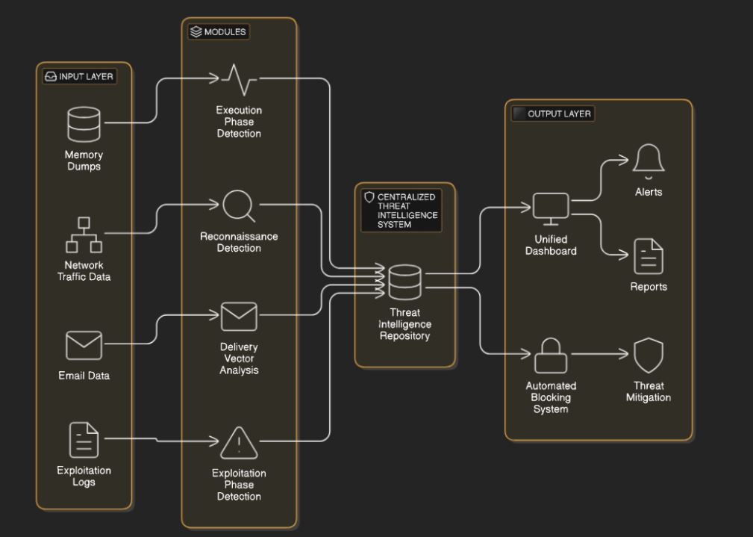
Overall System Diagram

Slide 8
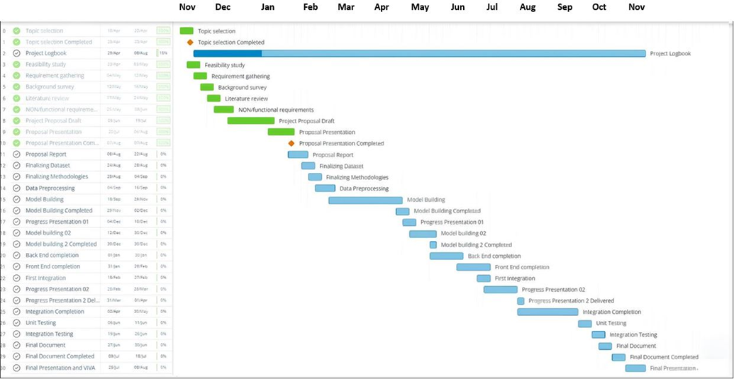
Gantt Chart

Slide 9

IT21812880 |N.H.S Chandrasekara
Reconnaissance Detection using Anomaly Based Clustering
IT21812880 | N.H.S Chandrasekara | R25-037

Slide 10
Introduction and Background
Cyberattack Reconnaissance Detection • Reconnaissance is the initial stage of cyberattacks, gathering information about target systems. • Traditional methods rely on signature-based systems, ineffective against new threats. • Anomaly-based clustering techniques identify deviations from normal network traffic, enabling early threat detection. • Study focuses on developing an advanced anomaly-based clustering framework for reconnaissance detection.
IT21812880 | N.H.S Chandrasekara | R25-037

Slide 11

Research Question
How can adaptive clustering improve APT detection during the reconnaissance stage?
IT21812880 | N.H.S Chandrasekara | R25-037

Slide 12
Research Gap
While anomaly-based clustering has been applied in other domains, its use in reconnaissance detection remains underexplored. Existing methods either lack scalability or generate high false-positive rates, limiting their practical application. This research aims to fill this gap by creating a novel clustering framework optimized for real-world network environments.
IT21812880 | N.H.S Chandrasekara | R25-037

Slide 13



Comparisons
Requirement | Research [1] | Research [2] | Research [3] | Research [4] | Research [5] | Proposed System
Real-time adaptability
Handling evolving traffic patterns
Integration of incremental learning
Clustering techniques for reconnaissance
IT21812880 | N.H.S Chandrasekara | R25-037

Slide 14
Objectives
Main-Objectives
This research aims to develop a real-time anomaly-based clustering framework to detect reconnaissance activities in network traffic. It focuses on minimizing false positives, ensuring high detection accuracy, and identifying abnormal traffic patterns to prevent potential attacks.
Sub-Objectives
Collect and preprocess network traffic logs, focusing on metadata like port scans and DNS lookups.
Develop a feature extraction pipeline to identify reconnaissance activity patterns.
Implement adaptive clustering models (K-Means, DBSCAN) with incremental learning for live data analysis.
Visualize detected anomalies in a real-time dashboard to enhance monitoring.
IT21812880 | N.H.S Chandrasekara | R25-037

Slide 15
Methodology
System Architecture
Tools and Technologies
Requirements
IT21812880 | N.H.S Chandrasekara | R25-037

Slide 16
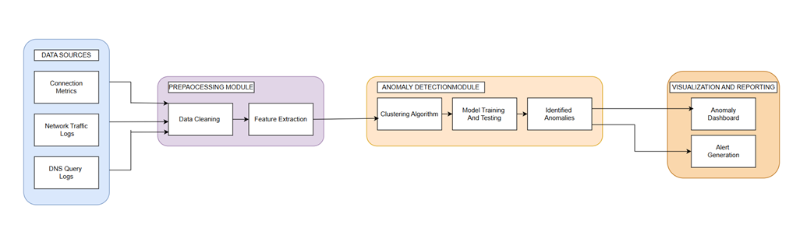
System Architecture
IT21812880 | N.H.S Chandrasekara | R25-037

Slide 17
Dataset
CICIDS2017 is a labeled dataset designed to help build and test Intrusion Detection Systems (IDS). It includes both normal (benign) and attack traffic, collected over 5 days from a real-like network with different computers and operating systems. The dataset has common attack types such as DDoS, DoS, Brute Force, Heartbleed, Infiltration, Botnet, and Web Attacks. It provides data in formats like PCAP (packet captures) and CSV files with over 80 features, making it useful for training machine learning models for cyberattack detection. [6]

Slide 18
Current Progress
Algorithm Selection
Training Pipeline
Feature Importance Analysis
Model Evaluation
Testing on Trained Model.
IT21812880 | N.H.S Chandrasekara | R25-037

Slide 19
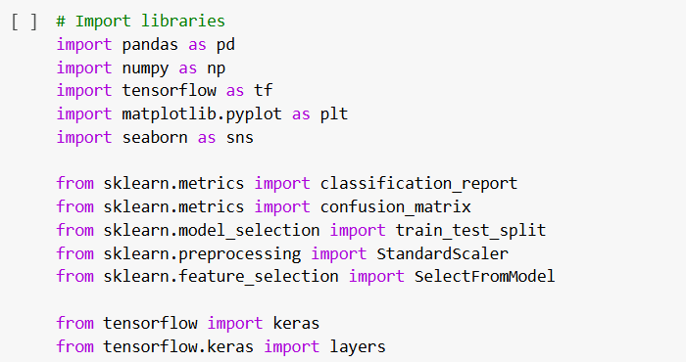
Project Evidence - Imports
IT21812880 | N.H.S Chandrasekara | R25-037

Slide 20
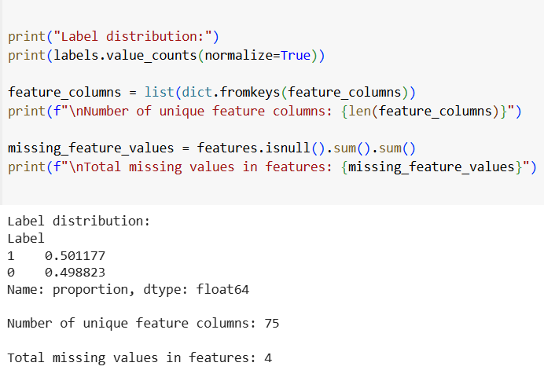
Project Evidence - Pre Processing
IT21812880 | N.H.S Chandrasekara | R25-037

Slide 21
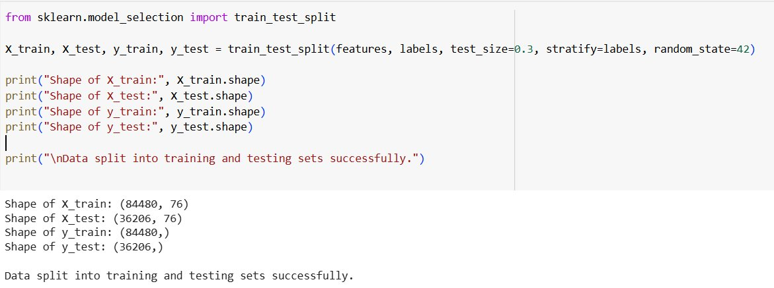
Project Evidence – Pre Processing
IT21812880 | N.H.S Chandrasekara | R25-037

Slide 22
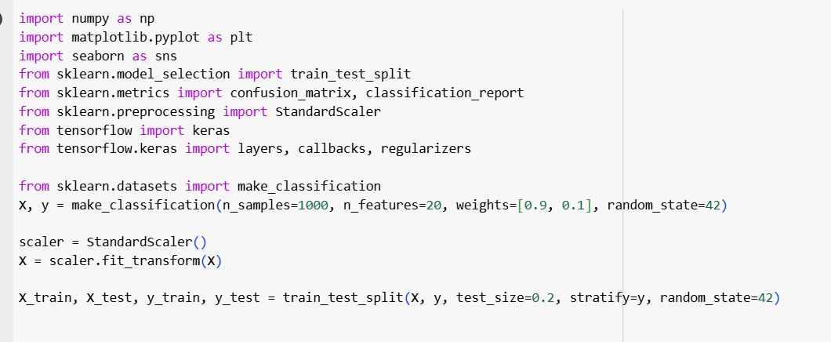
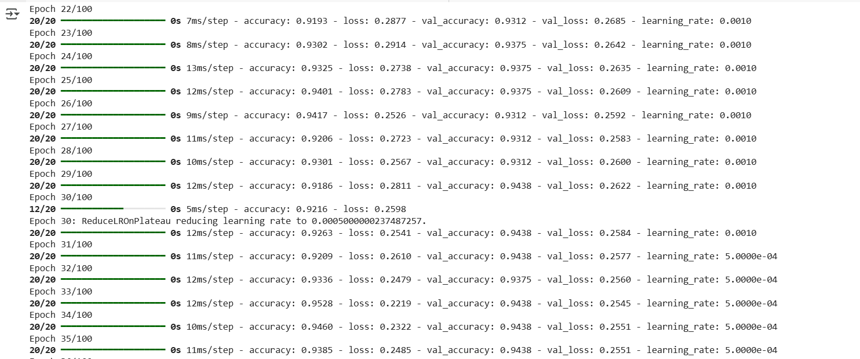
Project Evidence - Model Train
IT21812880 | N.H.S Chandrasekara | R25-037

Slide 23
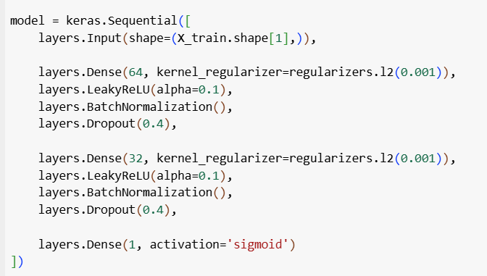
Project Evidence -Model Building
IT21812880 | N.H.S Chandrasekara | R25-037

Slide 24
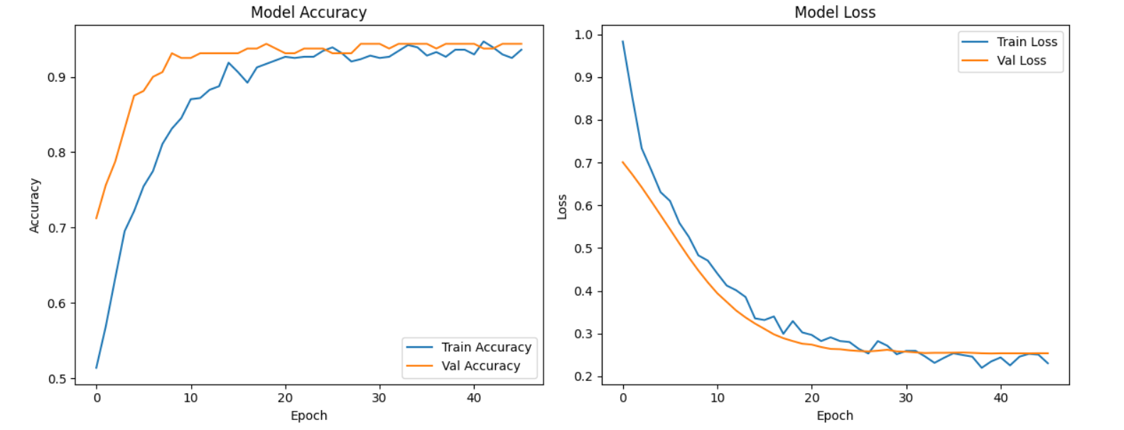
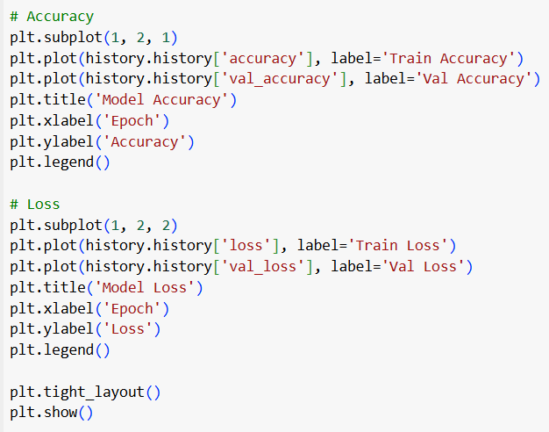
Project Evidence - Model Training Performance

Slide 25
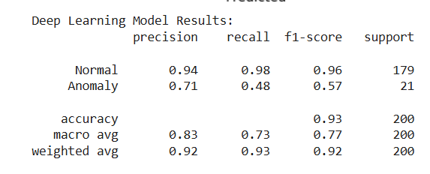
Project Evidence - Classification Report

Slide 26
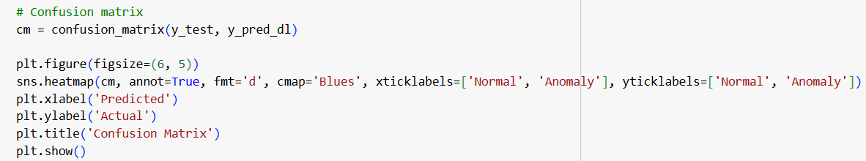
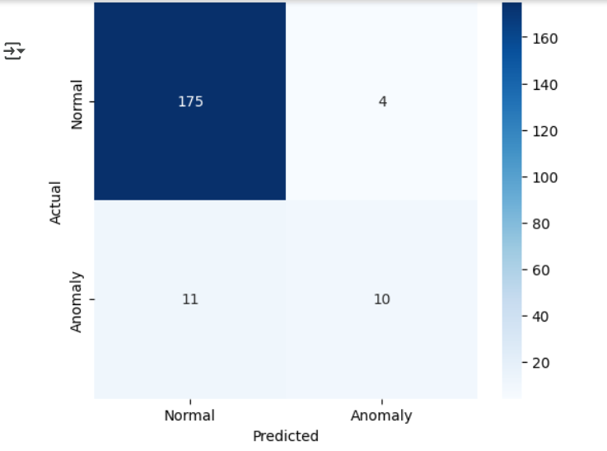
Project Evidence - Confusion Matrix

Slide 27
Future Work
Anomaly Dashboard
Network Anomaly Classification using DBScan and K-Means.
Alert Generation

Slide 28
Requirements
Functional Requirements
Real-time processing of network traffic logs.
Accurate detection of reconnaissance activities.
Non-Functional Requirements
Accuracy
Performance
Reliability
Efficiency
Scalability
IT21812880 | N.H.S Chandrasekara | R25-037

Slide 29
Tools, Technologies, and Algorithms
Tools: Wireshark
Technologies:
Development: Python
Building model: Jupiter Notebook , google colab
Algorithms: DBSCAN, k-means , deep learning
IT21812880 | N.H.S Chandrasekara | R25-037

Slide 30
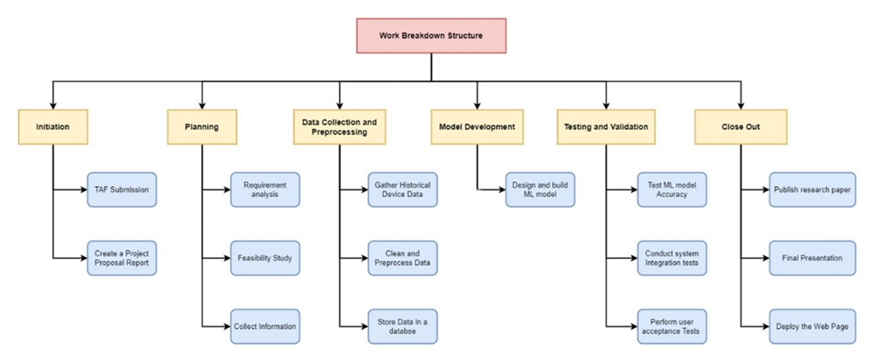
Work Breakdown Structure

Slide 31
References
[1]Wang, D., Nie, M., & Chen, D. (2023). BAE: Anomaly Detection Algorithm Based on Clustering and Autoencoder. Mathematics, 11(15), 3398–3398. https://doi.org/10.3390/math11153398
[2]Van Quan Nguyen, Viet Hung Nguyen, Nhien-An Le-Khac, & Van Loi Cao. (2020). Clustering-Based Deep Autoencoders for Network Anomaly Detection. Lecture Notes in Computer Science, 290–303. https://doi.org/10.1007/978-3-030-63924-2_17
[3]Bahlali, A. R., & Bachir, A. (2023). Machine Learning Anomaly-Based Network Intrusion Detection: Experimental Evaluation. Advanced Information Networking and Applications, 392–403. https://doi.org/10.1007/978-3-031-28451-9_34
[4]Encryption-Aware Anomaly Detection in Power Grid Communication Networks. (2015). Arxiv.org. https://arxiv.org/html/2412.04901v1
[5]E. Bou-Harb, M. Debbabi and C. Assi, "On detecting and clustering distributed cyber scanning," 2013 9th International Wireless Communications and Mobile Computing Conference (IWCMC), Sardinia, Italy, 2013, pp. 926-933, doi: 10.1109/IWCMC.2013.6583681. keywords: {Ports (Computers);Time series analysis;Training;IP networks;Servers;Doped fiber amplifiers;Protocols}, https://ieeexplore.ieee.org/abstract/document/6583681
[6] IDS 2017 | Datasets | Research | Canadian Institute for Cybersecurity | UNB
IT21812880 | N.H.S Chandrasekara | R25-037

Slide 32

IT21812330 |D.L.K.L Gangaboda
Delivery vector analysis through phishing email detection
IT21812330 | D.L.K.L.Gangaboda | R25-037

Slide 33
Research Question
How can phishing detection models enhance APT delivery phase security?
IT21812330 | D.L.K.L.Gangaboda | R25-037

Slide 34
Research Gap
Current phishing detection systems struggle to adapt to evolving phishing techniques due to reliance on static datasets and limited focus on metadata and attachments. The use of attention mechanisms in transformer models for feature prioritization is underexplored, and challenges in scalability and real-time deployment further highlight the need for adaptable and efficient solutions.
IT21812330 | D.L.K.L.Gangaboda | R25-037

Slide 35
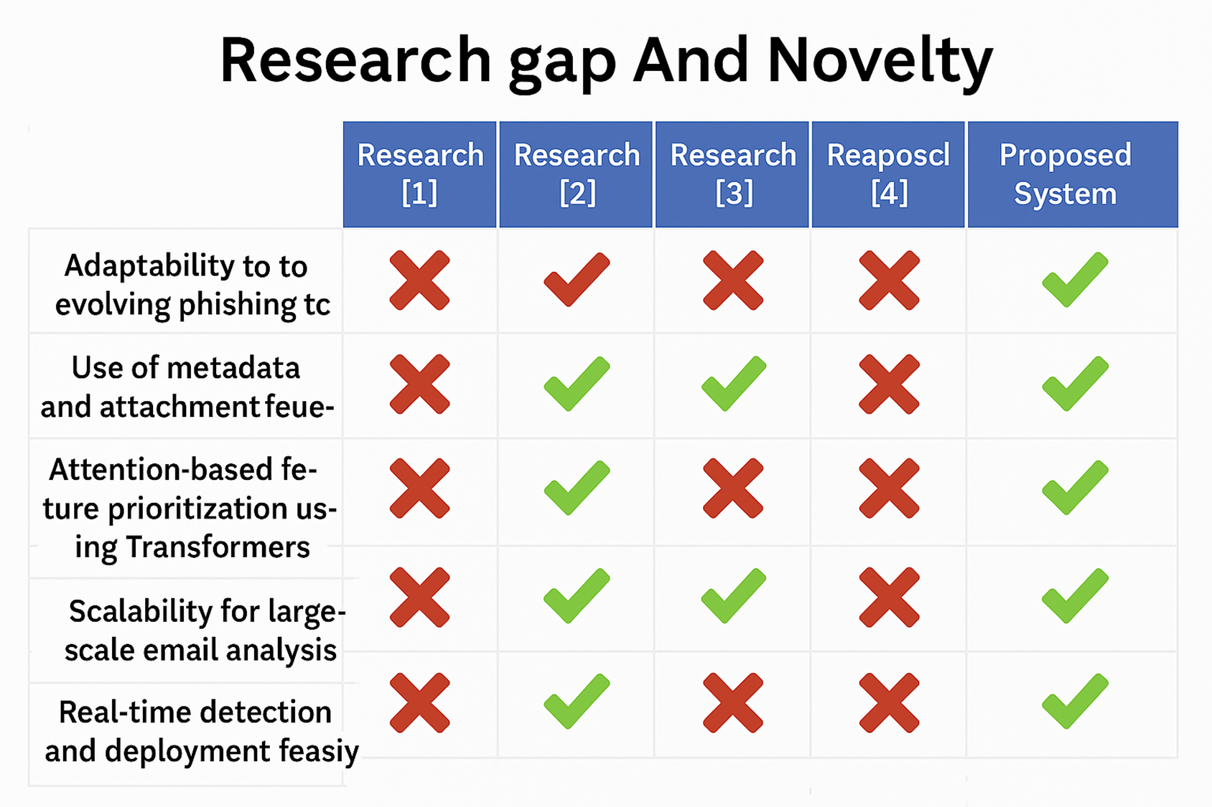


Slide 36
Objectives
Main Objective
Implement BERT-based transformers to detect phishing emails and implement a Naive bayes model for continuous learning.
Sub-Objectives
1.Collect a diverse dataset of phishing and legitimate emails, including text, metadata, and attachments.
2.Design a preprocessing pipeline to clean and tokenize email text and extract attachment features
3.Fine-tune a Transformer/BERT model for phishing email detection, incorporating attention mechanisms for feature prioritization.
4.Conduct experiments to evaluate precision, recall, and F1 scores.
5.Build a Naive bayes model for continuous learning to update the model with new phishing techniques.
IT21812330 | D.L.K.L.Gangaboda | R25-037

Slide 37

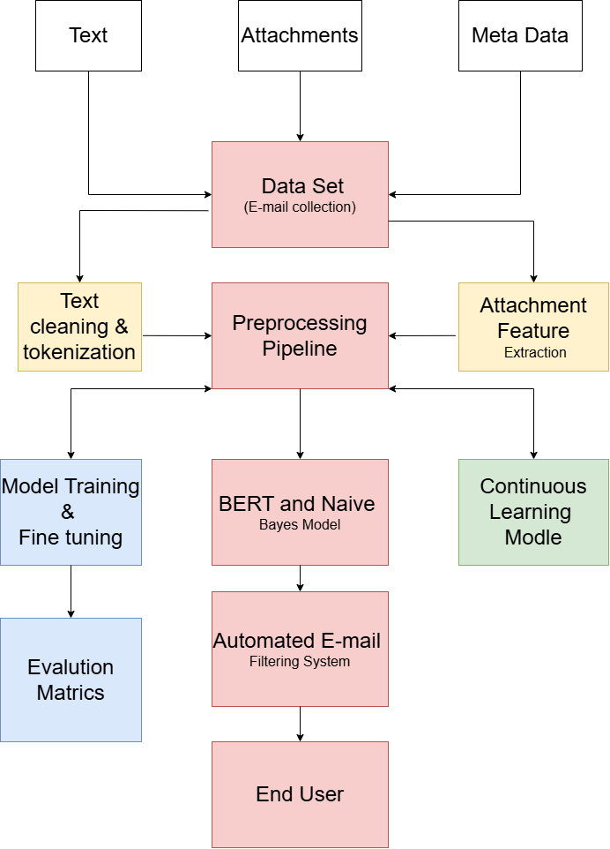
System Architecture
IT21812330 | D.L.K.L.Gangaboda | R25-037

Slide 38
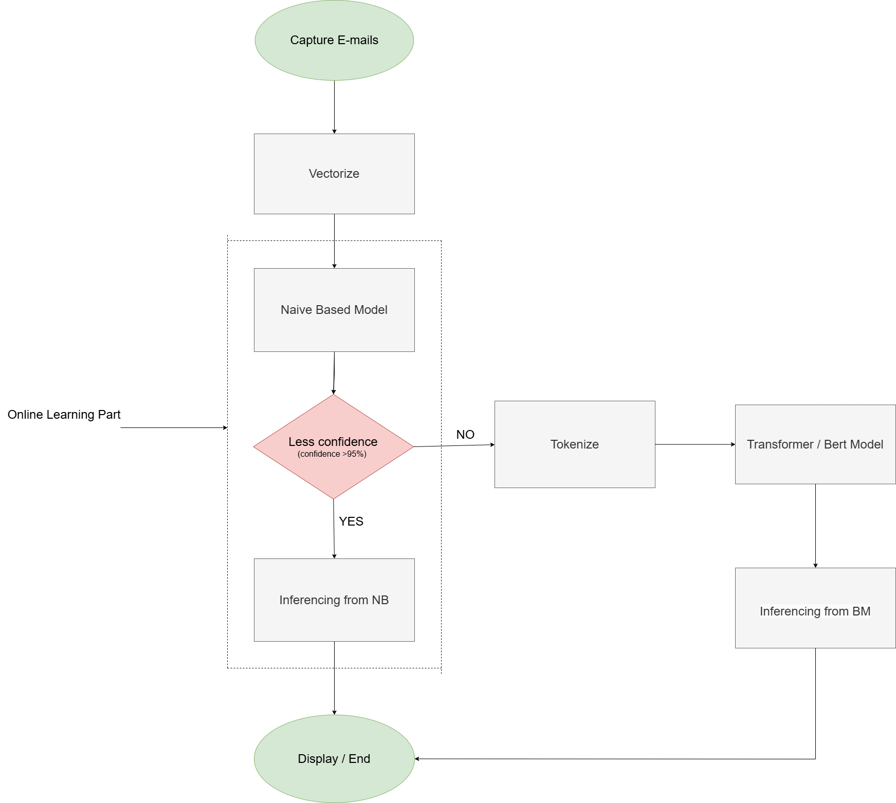
Working Process
IT21812330 | D.L.K.L.Gangaboda | R25-037

Slide 39
Methodology
1. Dataset Collection
Collect a diverse dataset of phishing and legitimate emails, including:
Text
Attachments
Meta Data
Text Data Sets
https://www.kaggle.com/datasets/subhajournal/phishingemails
https://www.kaggle.com/datasets/naserabdullahalam/phishing-email-dataset?select=phishing_email.csv
https://www.kaggle.com/api/v1/datasets/download/wanderfj/enron-spam
Attachments Data Sets
https://www.perplexity.ai/search/-uBv.w5coRx6rm5XyvkM__A?2=r
https://www.cs.jhu.edu/~mdredze/datasets/image_spam/
Metadata Data Sets
https://github.com/kregg34/EmailHeaderAnomalyDetection/tree/master
IT21812330 | D.L.K.L.Gangaboda | R25-037

Slide 40
2. Preprocessing Pipeline Design
Develop a preprocessing pipeline to:
Clean and tokenize email text.
Extract attachment features (e.g., file type, hash).
Details:
2.1 Preprocess part:
Use libraries like pandas and matplotlib.
Pandas (using for data manipulation,cleaning)
Matplotlib (using for data visualization)
2.2 Tokenize part:
Used libraries as a AutoTokenizer
AutoTokenizer (using for Tokenization of email text for Transformer models)
IT21812330 | D.L.K.L.Gangaboda | R25-037

Slide 41
3. Model Fine-Tuning
Fine-tune a Transformer/BERT model for phishing email detection.
Incorporate attention mechanisms to prioritize features.
Details:
Use AutoModel for sequence specification.
Auto model - Fine-tuning pre-trained Transformer models for sequence-specific tasks.
4. Model Evaluation
Conduct experiments to evaluate the model using:
Precision : Accuracy of phishing email predictions.
Recall : The ability to detect all phishing emails
F1 Scores : A balanced measure of precision and recall.
Libraries/Tools:
Used Scikit-learn, PyTorch,Transformers
IT21812330 | D.L.K.L.Gangaboda | R25-037

Slide 42
Scikit-learn: As a machine learning library
PyTorch: For Transformer/BERT implementation and fine-tuning.
Transformers : To create BERT model
5. Continuous Learning Mechanism
Build a mechanism to enable continuous learning and update the model with new phishing techniques.
Train Naive Bayes Model to continuous learning.
Implementation:
Create a new pipeline using a simple Python script.
IT21812330 | D.L.K.L.Gangaboda | R25-037

Slide 43
Tools, Technologies, and Algorithms
Tools:
Libraries for Preprocessing and Analysis:
pandas: For data manipulation and cleaning.
matplotlib: For data visualization.
Natural Language Processing (NLP):
AutoTokenizer: Tokenization of email text for Transformer models.
RoBERTa: For tokenization and text embeddings.
Deep Learning Frameworks:
Scikit-learn: As a machine learning library
PyTorch: For Transformer/BERT implementation and fine-tuning.
Transformers : To create BERT model
Machine Learning Libraries:
Scikit-learn: For evaluation metrics (precision, recall, F1 scores).
Cybersecurity-Specific Features:
Custom Python scripts for continuous learning and handling phishing-specific data (attachments, metadata).
IT21812330 | D.L.K.L.Gangaboda | R25-037

Slide 44
Tools, Technologies, and Algorithms
Technologies:
Transformer Models:
BERT: Bidirectional Encoder Representations from Transformers for phishing email detection.
AutoModel: Fine-tuning pre-trained Transformer models for sequence-specific tasks.
Feature Engineering:
Metadata extraction (e.g., email headers, sender details).
Attachment analysis (e.g., file type, hash computation).
IT21812330 | D.L.K.L.Gangaboda | R25-037

Slide 45
Tools, Technologies, and Algorithms
Algorithms:
NLP Algorithms:
Tokenization: Breaking down email text into meaningful tokens using models like RoBERTa.
Sequence Classification: Using Transformer models to classify emails as phishing or legitimate.
Attention Mechanisms: To prioritize significant parts of the email text or metadata.
Evaluation Metrics:
Precision: Accuracy of phishing email predictions.
Recall: The ability to detect all phishing emails.
F1 Score: A balanced measure of precision and recall.
Continuous Learning:
Naïve Bays Model : Probabilistic machine learning algorithm based model
IT21812330 | D.L.K.L.Gangaboda | R25-037

Slide 46
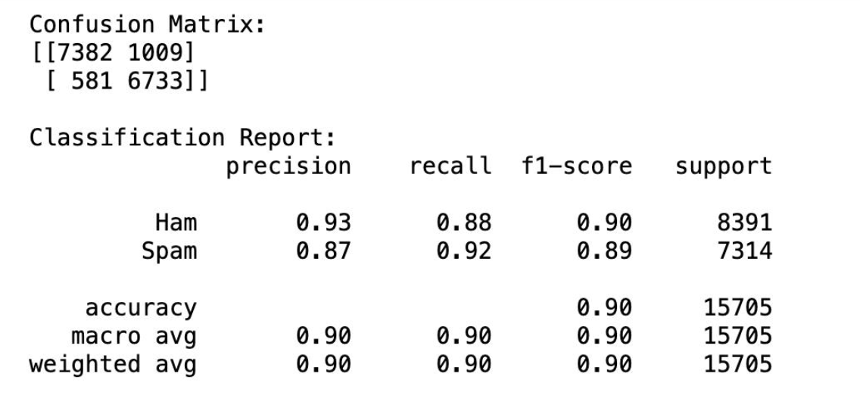
Project Evidence -Model Accuracy
IT21812330 | D.L.K.L.Gangaboda | R25-037

Slide 47
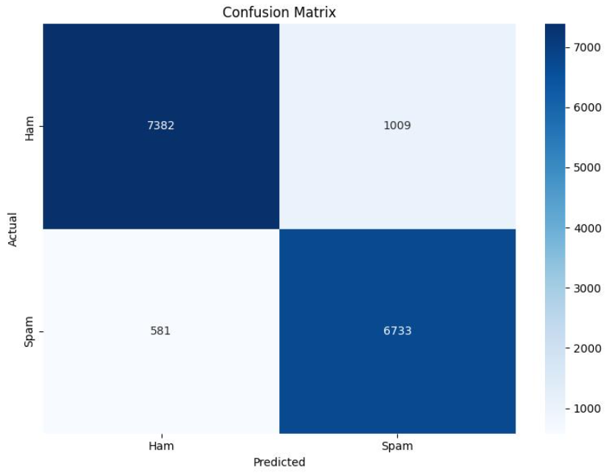
Project Evidence -Confusion Matrix
IT21812330 | D.L.K.L.Gangaboda | R25-037

Slide 48
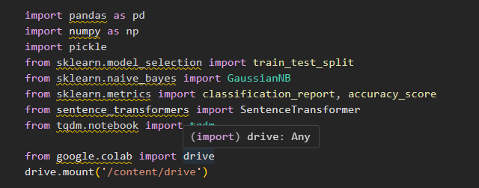
Project Evidence -Imports
IT21812330 | D.L.K.L.Gangaboda | R25-037

Slide 49
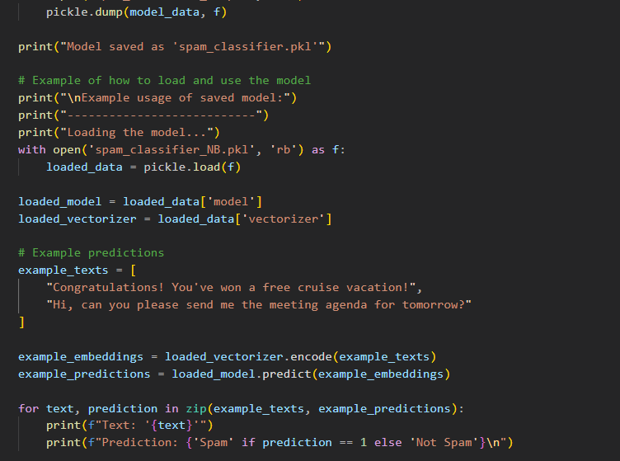
Project Evidence - Naïve Bayes Model
IT21812330 | D.L.K.L.Gangaboda | R25-037

Slide 50
References
https://www.kaggle.com/datasets/subhajournal/phishingemails
https://www.kaggle.com/datasets/naserabdullahalam/phishing-email-dataset? select=phishing_email.csv
https://www.perplexity.ai/search/-uBv.w5coRx6rm5XyvkM__A?2=r
https://github.com/kregg34/EmailHeaderAnomalyDetection/tree/master
S. Salloum, "A Systematic Literature Review on Phishing Email Detection Using Natural Language Processing Techniques," IEEE Access, vol. 10, p. 25, 2022.

Slide 51

IT21825682 | H.P.D.D.M Wickramasinghe
Malware Execution Phase detection using Memory Forensics
IT21825682 | H.P.D.D.M Wickramasinghe | R25-037

Slide 52
Research Question
How can temporal patterns in memory snapshots, derived through memory forensics, be utilized to detect malicious execution during an APT attack?
IT21825682 | H.P.D.D.M Wickramasinghe | R25-037

Slide 53
Research Gap
Despite the growing use of memory forensics in detecting and analyzing advanced persistent threats (APT), there remains a significant gap in applying real-time temporal anomaly detection for identifying malicious processes running in system memory during the execution phase.
IT21825682 | H.P.D.D.M Wickramasinghe | R25-037

Slide 54
Objective
Develop an advanced execution-phase detection framework that leverages memory forensics, temporal modeling, and real-time anomaly detection to identify and mitigate malicious processes during the execution phase of an APT attack.
IT21825682 | H.P.D.D.M Wickramasinghe | R25-037

Slide 55
Methodology
1. Dataset Collection
Memory snapshots from regular systems (normal behavior).
Memory dumps from systems with known malicious processes (e.g., APT attacks, malware infections).
2. Preprocessing Pipeline Design
Objective: Develop a preprocessing pipeline to clean, extract, and transform relevant features from memory dumps.
3. Temporal Analysis Using LSTM
Objective: Apply LSTM (Long Short-Term Memory) models to detect sequential anomalies in memory behavior.
IT21825682 | H.P.D.D.M Wickramasinghe | R25-037

Slide 56
Methodology
4. Mitigation and Response
Objective: Automatically mitigate detected threats by terminating malicious processes.
5. Real-Time Visualization
Objective: Provide real-time insights into detected threats and mitigation actions.
IT21825682 | H.P.D.D.M Wickramasinghe | R25-037

Slide 57
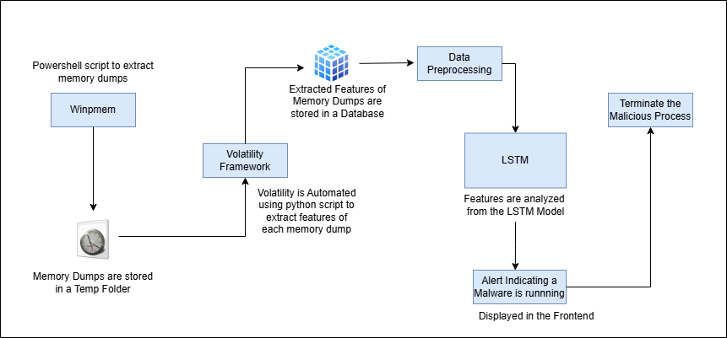
System Architecture
IT21825682 | H.P.D.D.M Wickramasinghe | R25-037

Slide 58
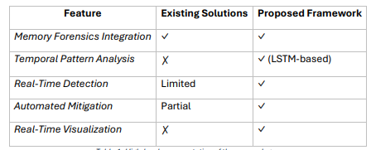
Comparisons

Slide 59
Tools and Technology
Memory Forensics Tools: Winpmem, Volatility
Algorithm: LSTM (Long Short-Term Memory) network.
Feature Extraction: Leveraging memory dumps to identify behavioral.
Model Training: TensorFlow / Keras , Jupyter Notebook
Coding: Python, Powershell, React JS
Testing: Postman
IT21825682 | H.P.D.D.M Wickramasinghe | R25-037

Slide 60
Requirements
1. Functional Requirements
The system should be able to capture memory snapshots from both normal and compromised systems.
Malware detection from memory dumps.
The system must terminate the executed malware process.
2. Non-Functional Requirements
Accuracy
Scalability
Reliability
IT21825682 | H.P.D.D.M Wickramasinghe | R25-037

Slide 61
Dataset
The CIC-MalMem-2022 dataset is a balanced and labeled dataset designed for detecting obfuscated malware through memory analysis. It contains 58,596 memory dump records with 56 engineered features and an equal split of 29,298 benign and 29,298 malicious samples. Malicious samples span 15 malware families across Spyware, Ransomware, and Trojan Horse categories, simulating real-world attack scenarios. [1]
IT21825682 | H.P.D.D.M Wickramasinghe | R25-037

Slide 62
Current Progress
Algorithm Selection.
Training Pipeline.
Feature Importance Analysis.
Model Evaluation.
Testing on Trained Model.
IT21825682 | H.P.D.D.M Wickramasinghe | R25-037

Slide 63
Future Work
Feature Extraction from memory dumps.
Classification of Malware.
Frontend Dashboard.

Slide 64
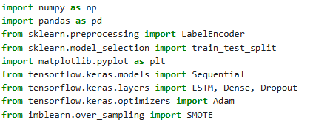
Evidences - Imports
NumPy: For handling numerical operations and arrays.
Pandas: Used for handling datasets.
Scikit-learn: For preprocessing and splitting data into training and testing sets.
Matplotlib: For creating plots and visualizations.
TensorFlow Keras: For building and training neural network models.
SMOTE: For handling imbalanced datasets by generating synthetic data points.
IT21825682 | H.P.D.D.M Wickramasinghe | R25-037

Slide 65
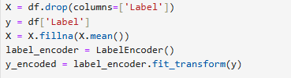
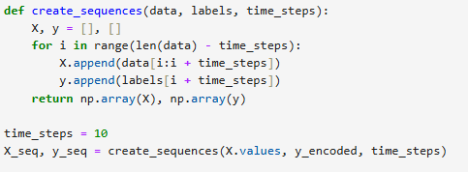
Evidences
Define features for X and Label for Y
Generate Sequences of Data.
IT21825682 | H.P.D.D.M Wickramasinghe | R25-037

Slide 66
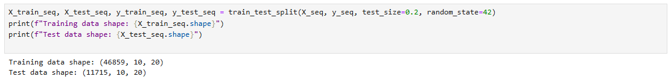
Evidences – Data Splitting
Dataset is split into Test Data and Training Data
IT21825682 | H.P.D.D.M Wickramasinghe | R25-037

Slide 67
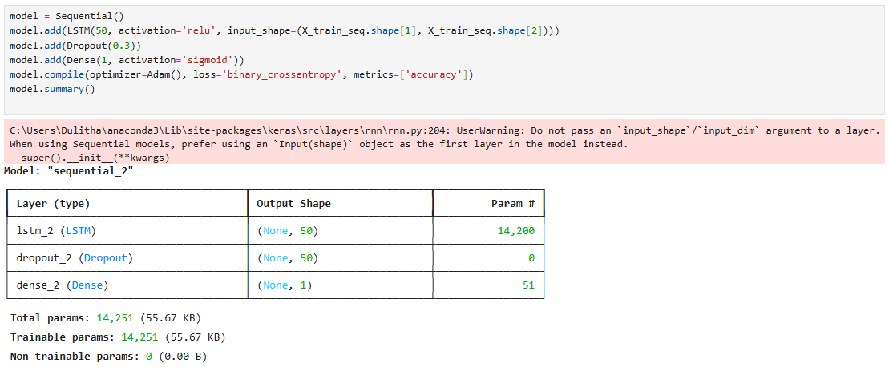
Evidences
Construction of LSTM neural network model using Keras
IT21825682 | H.P.D.D.M Wickramasinghe | R25-037

Slide 68
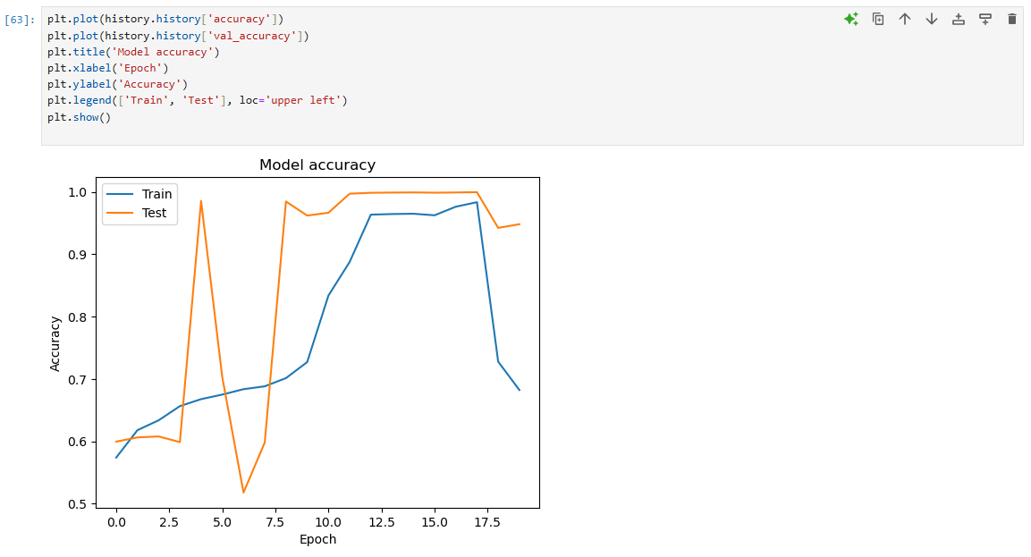
Evidences – Model Accuracy
IT21825682 | H.P.D.D.M Wickramasinghe | R25-037

Slide 69
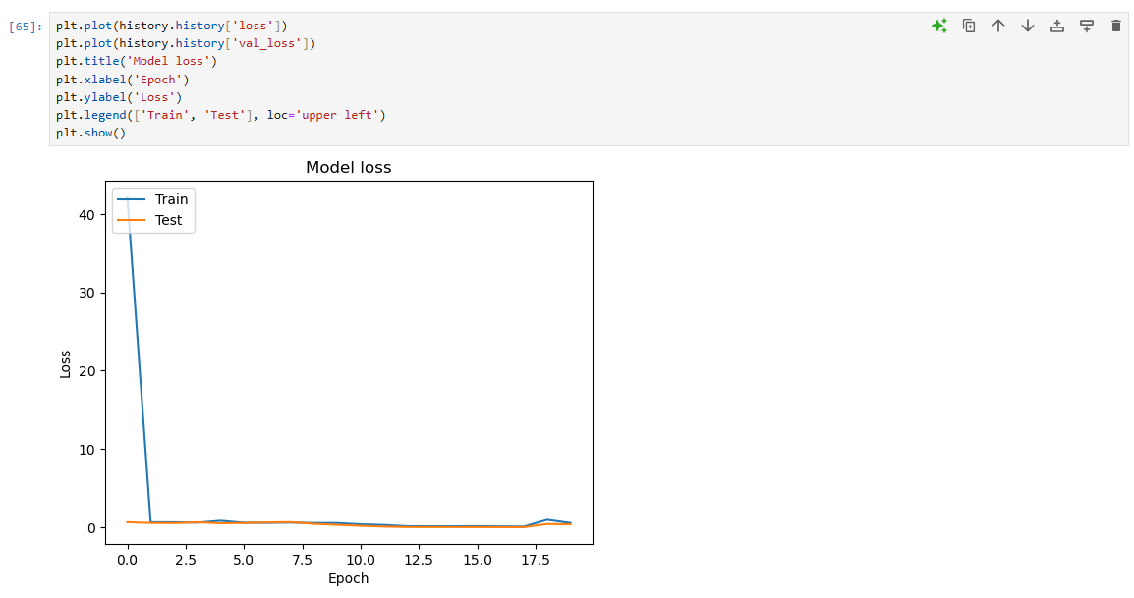
Evidences – Model Loss
IT21825682 | H.P.D.D.M Wickramasinghe | R25-037

Slide 70
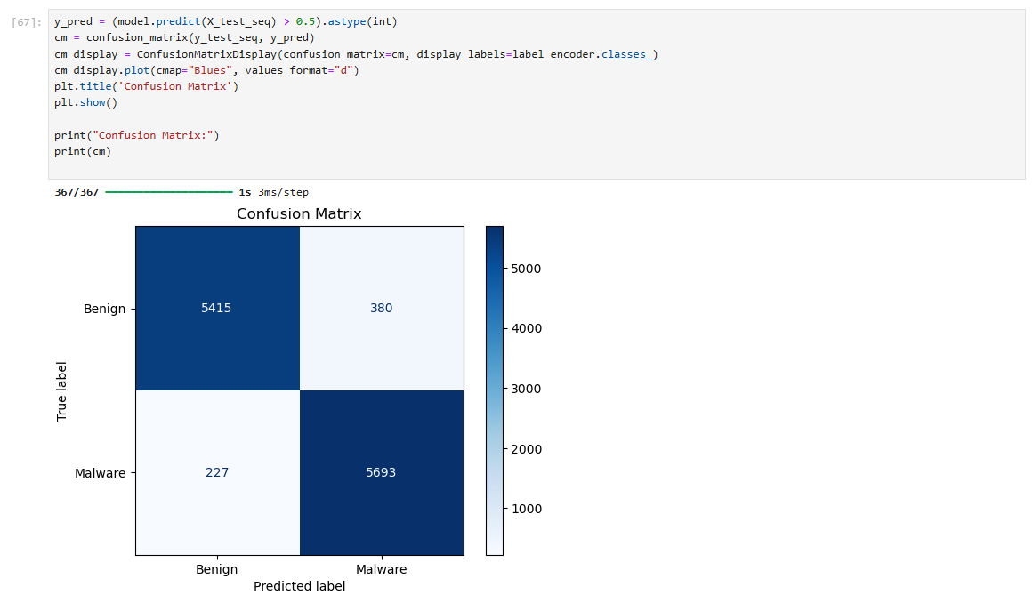
Evidences – Confusion Matrix
IT21825682 | H.P.D.D.M Wickramasinghe | R25-037

Slide 71
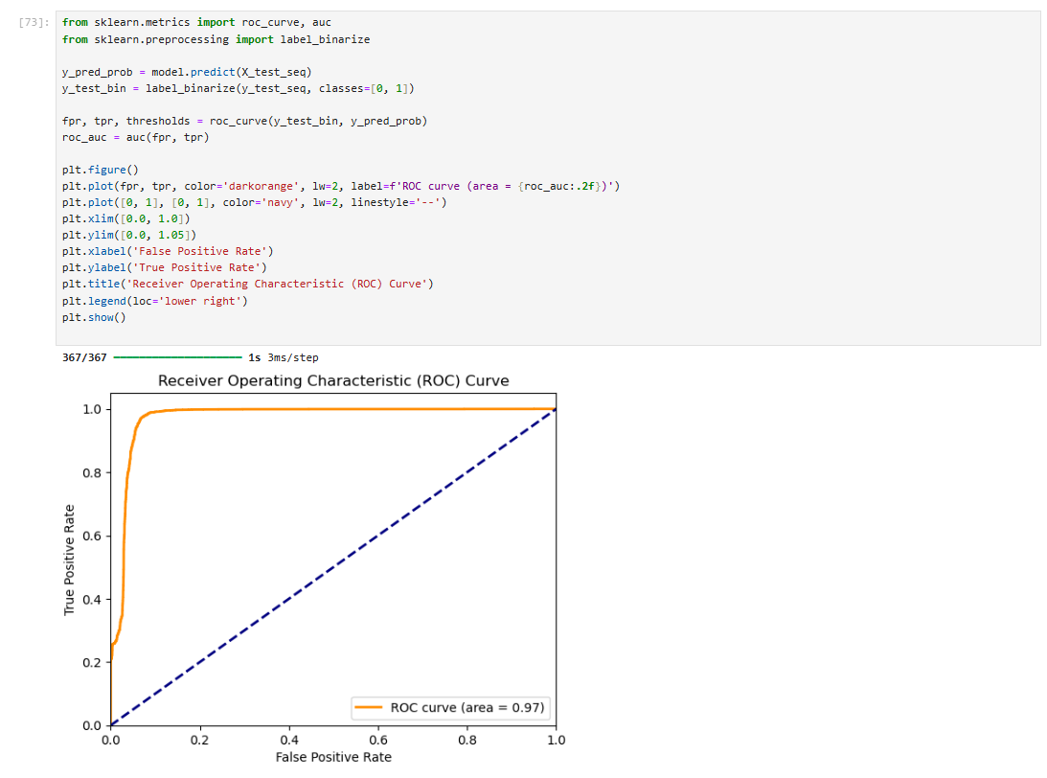
Evidences – ROC Curve
IT21825682 | H.P.D.D.M Wickramasinghe | R25-037

Slide 72
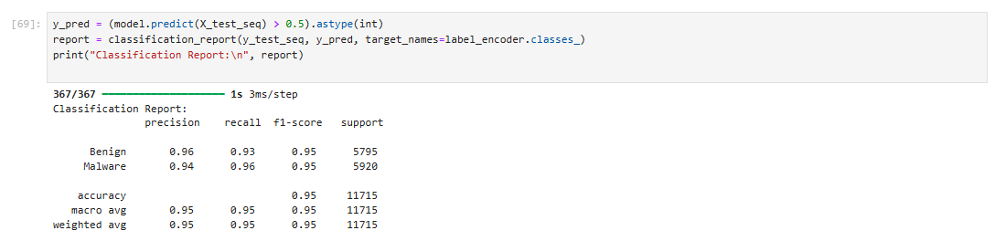
Evidences – Classification Report
IT21825682 | H.P.D.D.M Wickramasinghe | R25-037

Slide 73
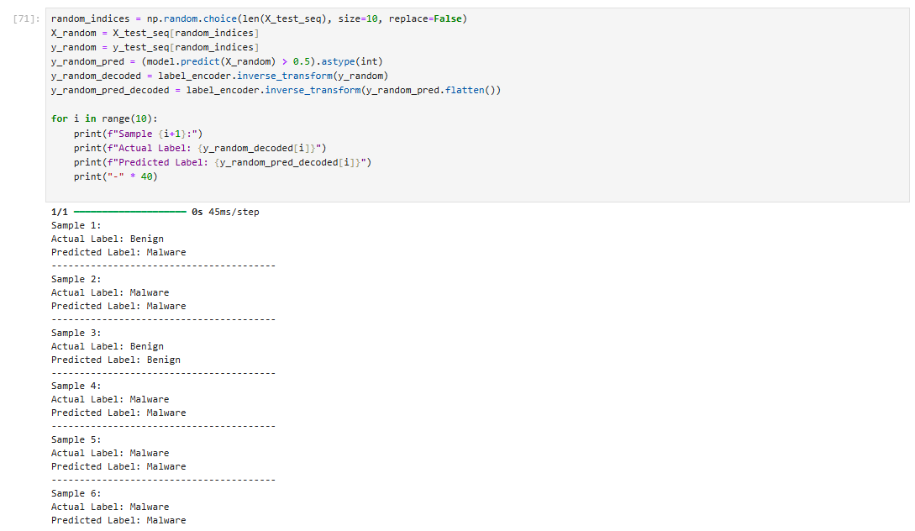
Evidences – Testing
IT21825682 | H.P.D.D.M Wickramasinghe | R25-037

Slide 74
References
[1] Malware Memory Analysis | Datasets | Canadian Institute for Cybersecurity | UNB
IT21825682 | H.P.D.D.M Wickramasinghe | R25-037

Slide 75

IT21825996 | I.D. Sellahewa
EXPLOITATION BEHAVIOR PROFILING USING REINFORCEMENT LEARNING
IT21825996 | I.D. Sellahewa | R25-037

Slide 76
Introduction
Advanced Persistent Threats (APTs) exploit system vulnerabilities post-infiltration.
Behavior profiling is crucial to detecting these exploitation patterns in real-time.
Traditional models lack adaptability to evolving attack behaviors.
This research focuses on using reinforcement learning techniques to detect and profile exploitation behavior in system logs.

Slide 77
Research Question
How can reinforcement learning-based behavior profiling enhance the detection of exploitation phases in advanced persistent threats?
IT21825996 | I.D. Sellahewa | R25-037

Slide 78
Research Gap
Current anomaly detection methods often rely on static signatures or rule-based engines.
Many fail to capture evolving and subtle exploitation patterns in logs.
There is limited exploration of reinforcement learning for dynamic behavior profiling in security logs

Slide 79
Novelty
Introduces a DQN-inspired supervised model using reward signals for classification.
Leverages sequence encoding and log profiling to simulate attacker behavior.
Bridges the gap between traditional ML classification and reward-based behavior modeling.

Slide 80
Objectives
Main Objective:
Profile exploitation behavior using a reward-driven learning framework.
Sub-Objectives:
Encode and preprocess log sequences.
Train a DQN-inspired neural network for classification.
Apply reward-based correction for improved exploitation detection.
Evaluate using precision, recall, F1-score.
IT21825996 | I.D. Sellahewa | R25-037

Slide 81
Methodology
Dataset: HDFS syslog data from distributed systems (https://www.kaggle.com/datasets/omduggineni/loghub-hadoop-distributed-file-system-log-data/data).
Preprocessing
Tokenization and Label Encoding of log sequences.
Padding to fixed sequence lengths.
Model Design
Feedforward neural network with DQN-style training.
MSE loss with reward-based feedback.
Evaluation: Scikit-learn’s classification metrics.
IT21825996 | I.D. Sellahewa | R25-037

Slide 82
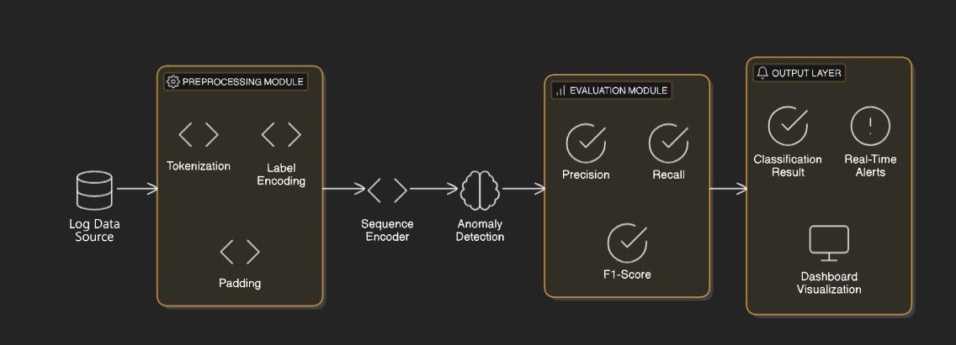
Model Diagram Architecture
IT21825996 | I.D. Sellahewa | R25-037

Slide 83
Current Progress
✅ Dataset loaded and cleaned.
✅ Sequences encoded, padded to uniform length.
✅ DQN-style model designed and trained on labeled data.
✅ Evaluation completed using classification report.
⏳ Next Step- Add adversarial behavior simulation using reinforcement learning loop.
IT21825996 | I.D. Sellahewa | R25-037

Slide 84
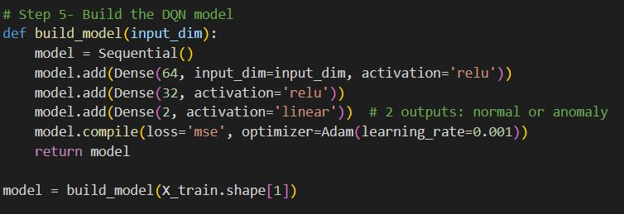
Project Evidence

Slide 85
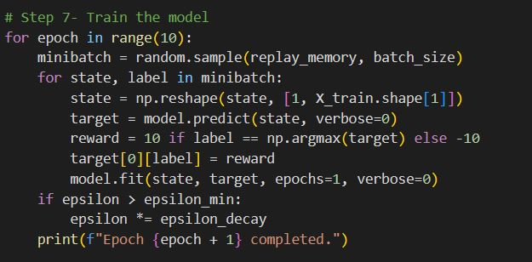
Project Evidence

Slide 86
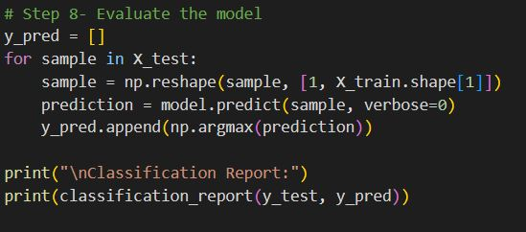
Project Evidence

Slide 87
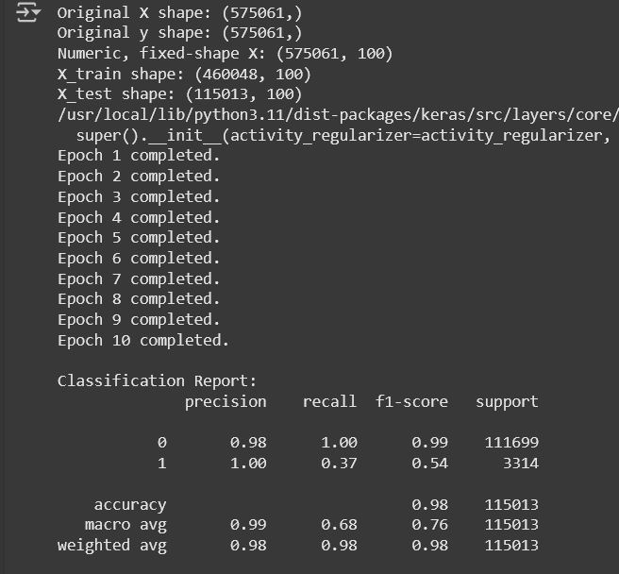
Project Evidence- model Accuracy

Slide 88
Requirements
Functional
Detect and classify exploitation behaviors in logs.
Adapt to evolving attack patterns via reward updates.
Non-Functional
High accuracy and low false positives.
Efficient memory use

Slide 89
Tools, Technologies, and Algorithms
Languages: Python
Frameworks: TensorFlow, Keras, Scikit-learn
Techniques
DQN-inspired learning
Sequence encoding
Reward-based training
Tools
Google Colab
Kaggle Datasets
NumPy, Pandas, Matplotlib
IT21825996 | I.D. Sellahewa | R25-037

Slide 90
References
• A. Coggan, "Exploration and Exploitation in Reinforcement Learning," CRA-W DMP Final Report, 2004. [Online]. Available: https://archive2.cra.org/Activities/craw_archive/dmp/awards/2004/Coggan/FinalReport.pdf • Y. Hao, H. Xu, W. J. Gao, and Y. Wang, "Exploration versus Exploitation in Reinforcement Learning: A Stochastic Control Approach," arXiv preprint arXiv:1812.01552, 2018. [Online]. Available: https://arxiv.org/abs/1812.01552 • G. Dorigo and M. Colombetti, "Behavior-Based Reinforcement Learning," Artificial Intelligence Laboratory, MIT, 1997. [Online]. Available: https://people.csail.mit.edu/gdk/pubs/bbrl-paper.pdf • F. Zhang, X. Zhang, and J. Zhang, "Behavior-Guided Actor-Critic: Improving Exploration via Learning Policy Behavior Representation for Deep Reinforcement Learning," arXiv preprint arXiv:2104.04424, 2021. [Online]. Available: https://arxiv.org/abs/2104.04424 • Z. Chen, T. Jiang, and X. Zhang, "Balancing Exploration and Exploitation in Reinforcement Learning Using Information Theory," in IEEE Transactions on Neural Networks and Learning Systems, vol. 28, no. 4, pp. 847–859, Apr. 2017. [Online]. Available: https://ieeexplore.ieee.org/document/7952670
Data Set - https://www.kaggle.com/datasets/omduggineni/loghub-hadoop-distributed-file-system-log-data/data
IT21825996 | I.D. Sellahewa | R25-037

Slide 91
Q n A?

Slide 92
Thank You

